Slide 1
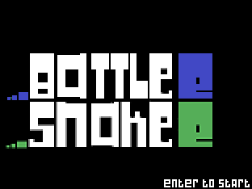
By Matthew Lee and Nadia Zhou

Slide 2
Project Description
Multiplayer (2 player) Snake Game
KeyBoard Controlled with Audio Sound Effects
Game Tracking and Visual Graphic Block Memory
~Randomized Food Plotting
2 surprise easter eggs :)
Two Players Face Off in a Battlesnake Competition - One Blue, One Green
Chasing one another within the bounds of the grid, seek food to gain length advantage
Hit the outside grid or each other and lose - tie if it is a head to head

Slide 3
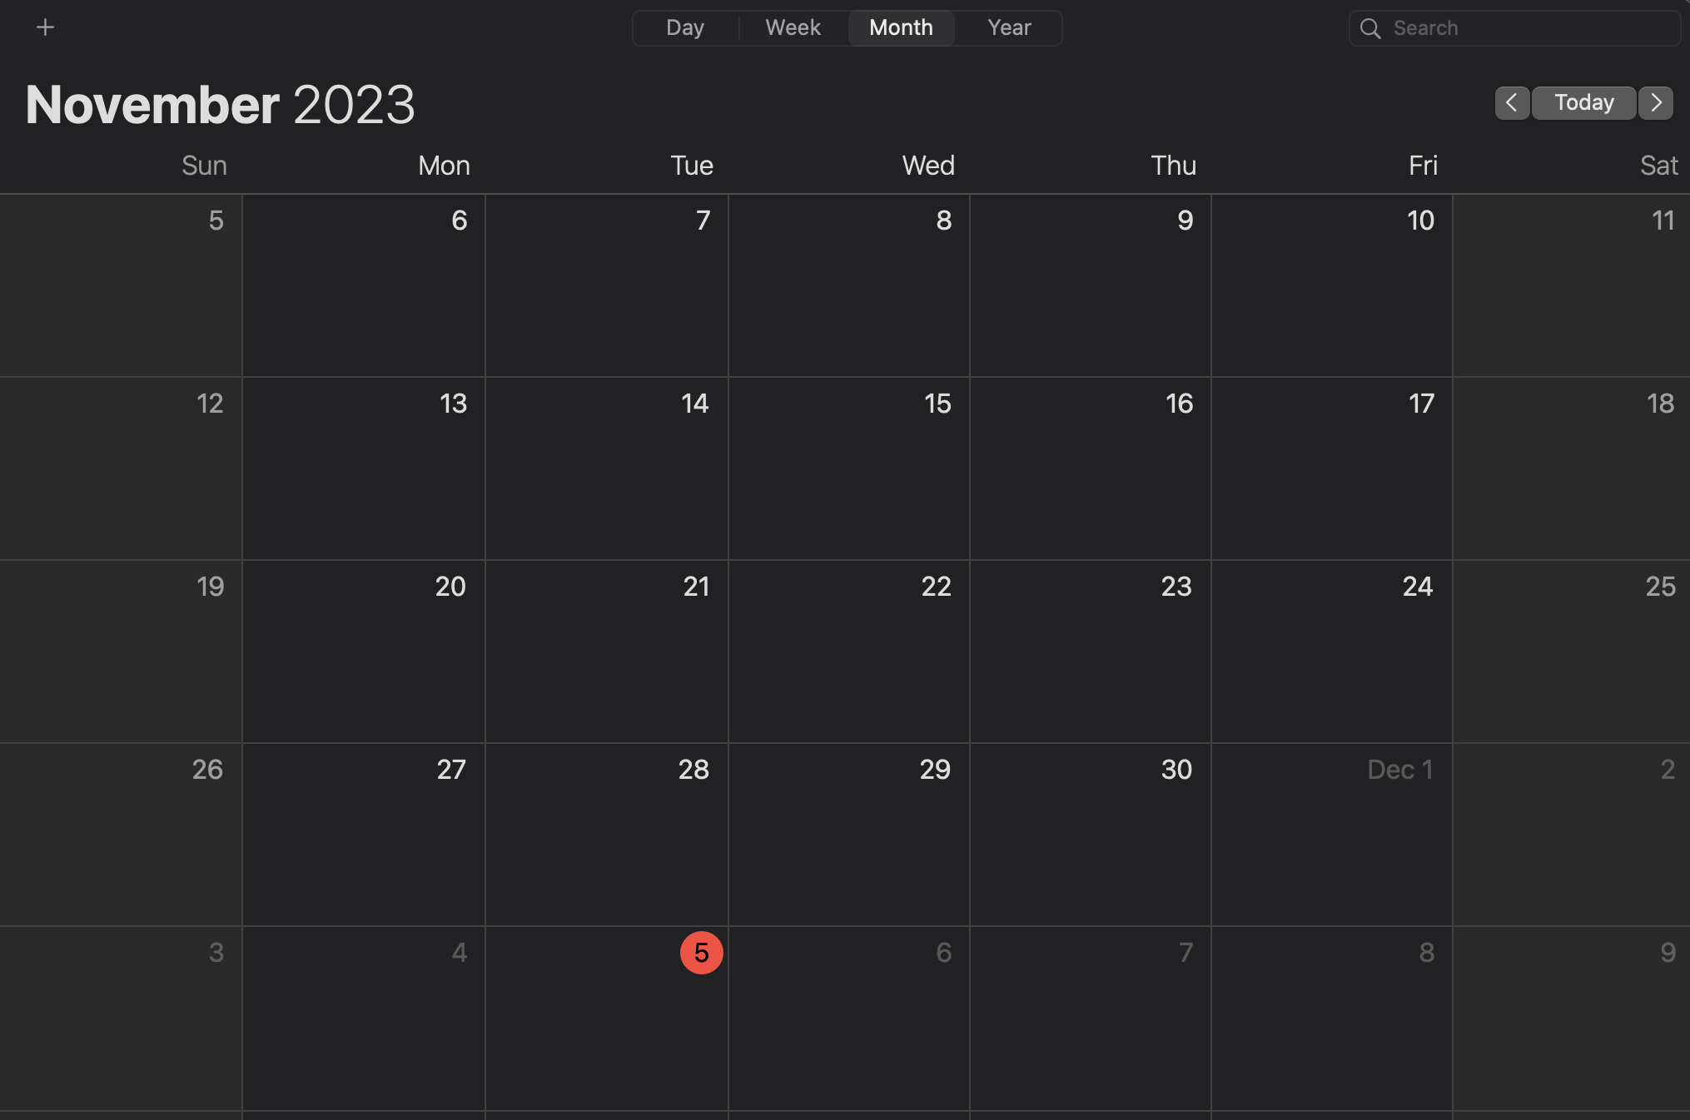
Timeline
reading week
Lab 7
standalone
components
integration
DEMO
Reading Week Proposal Drafted
Lab 7 Full Completion (Draw Pixel)
Lab 8 Completion (Pong, Single Buffering)
FSM, Control Path, Data Path Modelsim
Preliminary Code Written and Pushed to Shared Drive
First Day In Lab Testing (Individual Modules)
PS2 KeyBoard Stand Alone Success
MIF, BRAM Stand Alone Success
INTEGRATION START
Baseline Proposed Implementation
VGA Integration & Double Buffering Standalone
Keyboard Integration
MIFs & Graphics, BRAM integration
Audio + Multiplayer Add ons

Slide 4
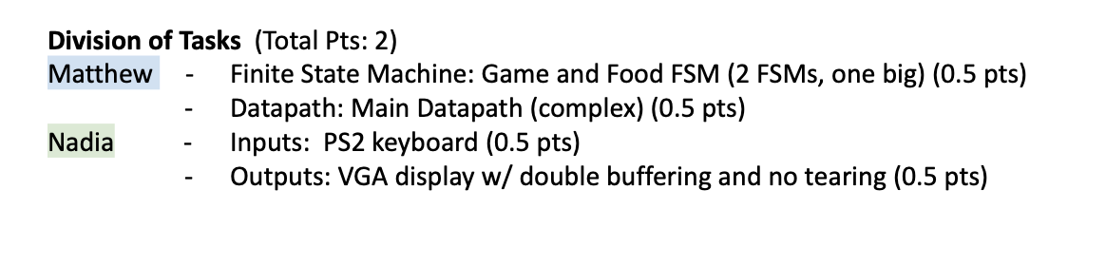
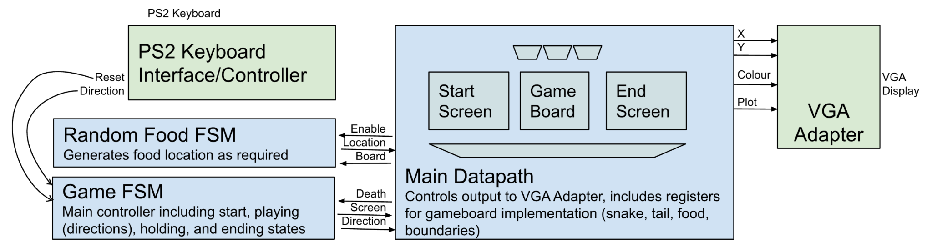
Initial Project Idea and Complexity Points (from proposal)

Slide 5
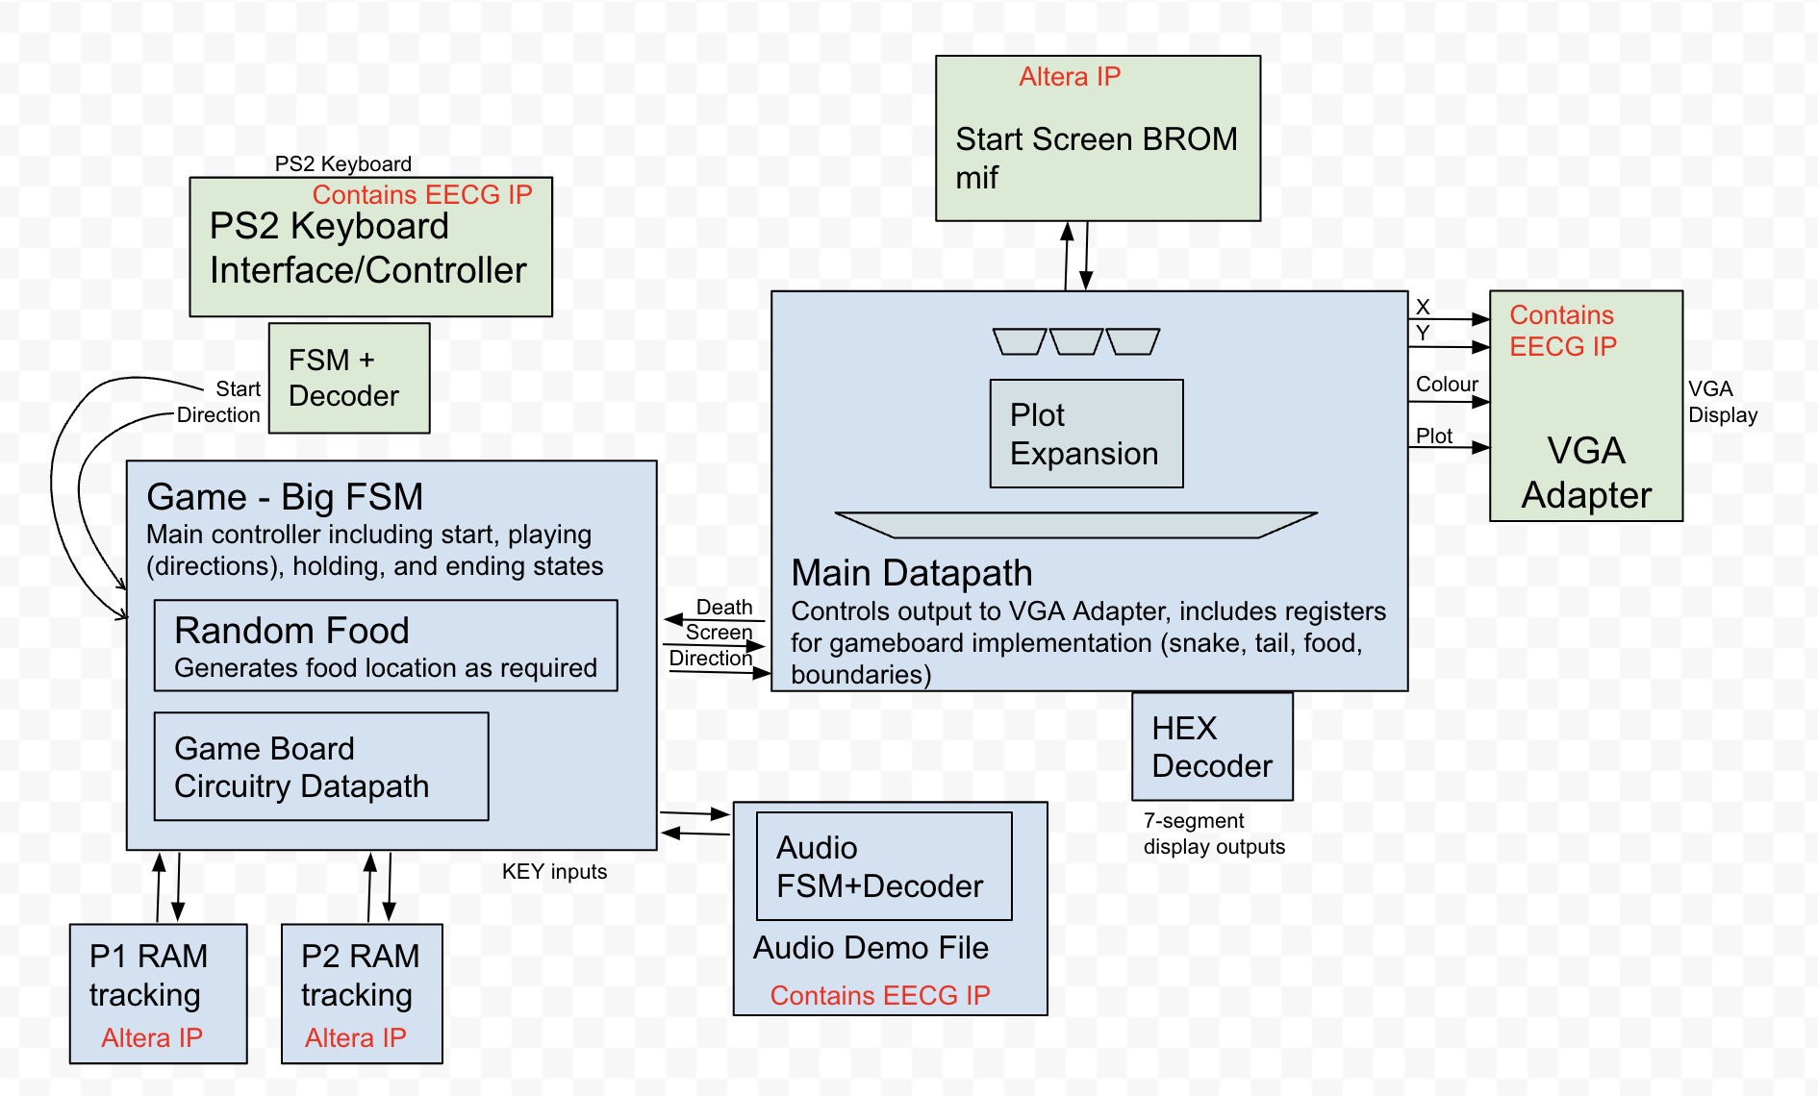
Final Project Complexity Points 1500+ lines written, 3000+ total

Slide 6
Work Distribution
Matthew (2.125)
Big FSM (23 states) + small FSM (0.5+)
Gameboard Datapath and Output Datapath (0.5)
On-chip Memory (0.25)
Audio Output (0.5)
HEX Output (0.125)
KEY Inputs (0.25)
Nadia (1.5)
PS2 KeyBoard (0.5)
small FSM (0.25)
mif datapath (0.25)
VGA (0.25)
MIF BROM Memory Storage (0.25)

Slide 7
What Went Wrong? (Parts, Milestones, Bugs)
Lab7 took far longer than expected, had difficulty integrating FSM and Datapath with the provided VGA interface
Underestimation of time required for everything (hardware is hard)
Audio: database file missing
problem identified: something with ecf accounts, just used different computer
Keyboard: needed to hold key down
fixed with condition change

Slide 8
What Can Be Improved?
Added Functionality
Scoreboard
More audio outputs
Even more players
Snake Customization (colour, face)
more mif outputs
AI opponent…
- Quality Improvements
Improved visuals with higher screen resolution and 8 bit colour
Better instructions
In-between block moving animations
Organizational
Better separation of modules (more black-box like)

Slide 9

DEMO

Slide 10
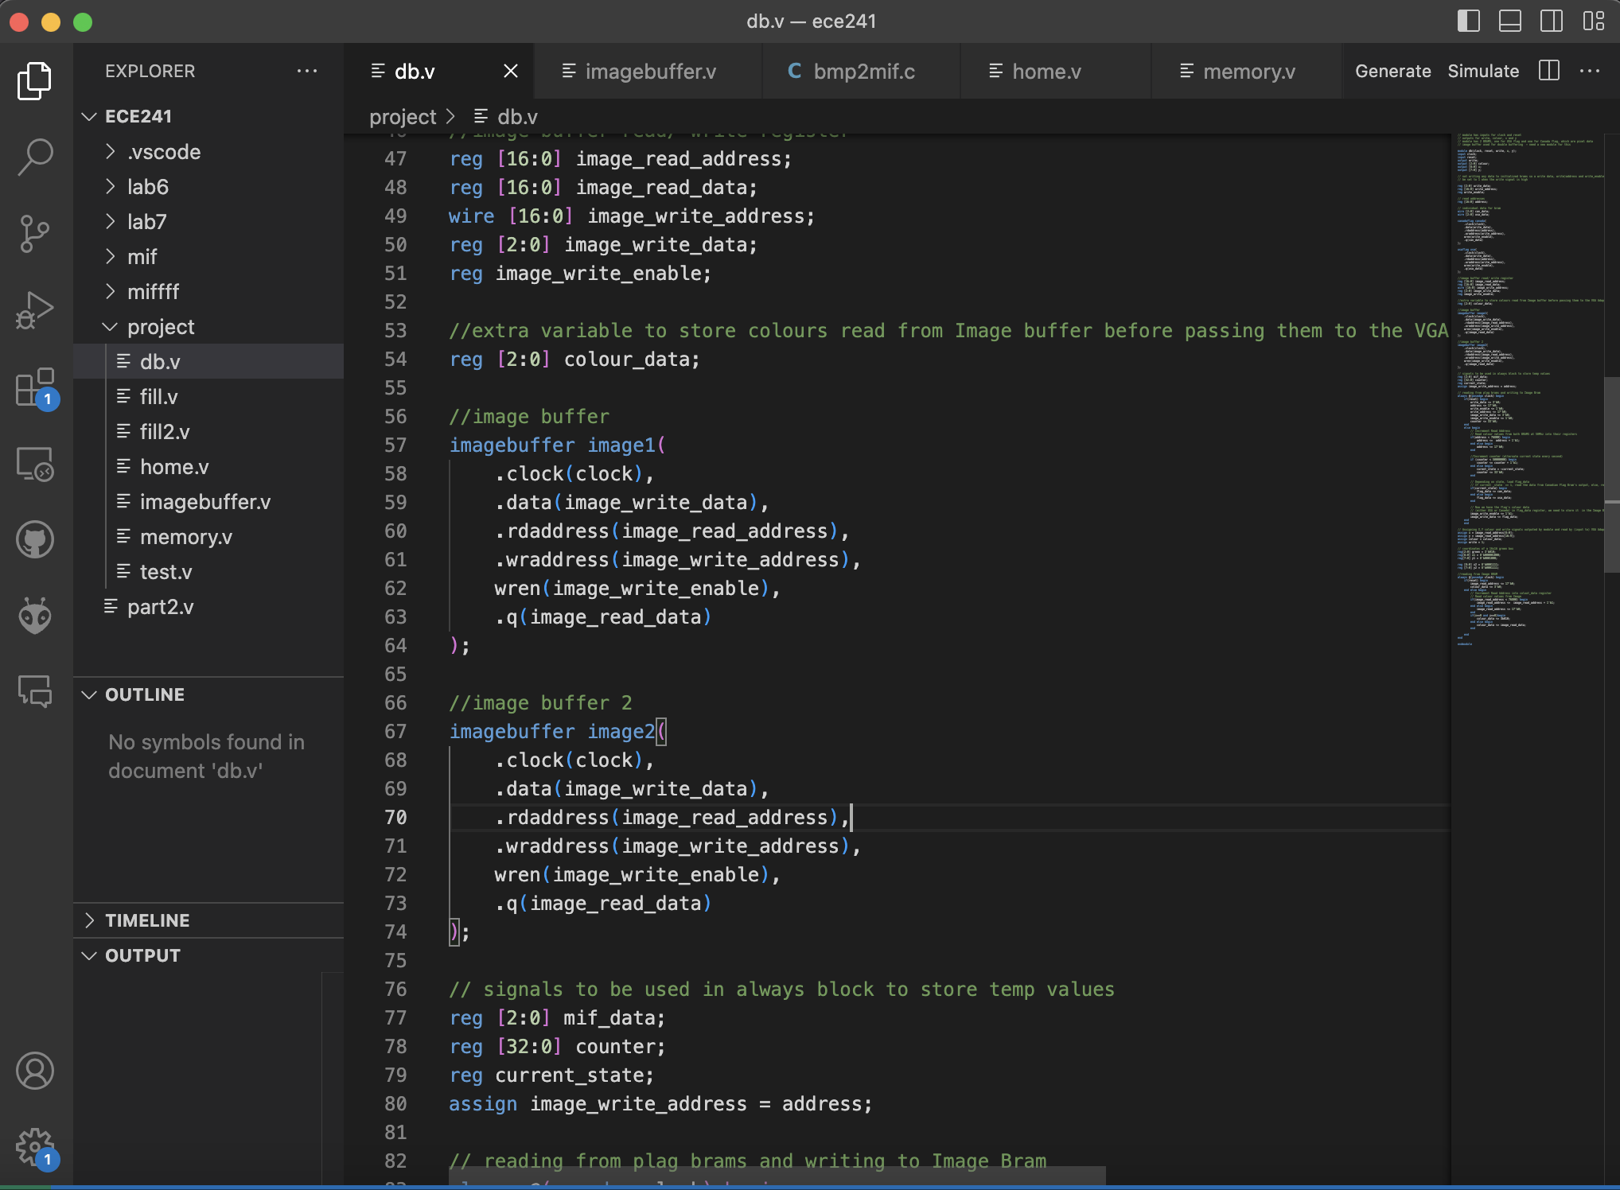
DB
Plan:
for double buffering,
make an fsm and in the vga adapter they have a video memory, make two write enables for it and two outputs and u basically switch them in ur fsm so whenever vga_vs goes low u switch ur frames

